Slide 1
Employee Data Analysis using Excel
STUDENT NAME: SANGAMITHRA I
REGISTER NO : 312209231
DEPARTMENT : B.COM BANK MANAGEMENT
COLLEGE : ANNA ADARSH COLLEGE

Slide 2
PROJECT TITLE
Employee Performance Analysis using Excel

Slide 3


AGENDA
Problem Statement
Project Overview
End Users
Our Solution and Proposition
Dataset Description
Modelling Approach
Results and Discussion
Conclusion
3/21/2024 Annual Review

Slide 4

PROBLEM STATEMENT
FOR IS ACHIVEMENT
FOR IS INCREMENT
Effectively consider multiple perspectives and approaches before making decisions
Displayed a consistently strong ability to tackle challenging proble efficiently

Slide 5

PROJECT OVERVIEW
analysing the performance of the employee by considering various factor
like gender performance score rating performance analysis in order to identify the trends and patterns of different categories of employee like high medium low compare strengths and weaknesses recommmend goals

Slide 6
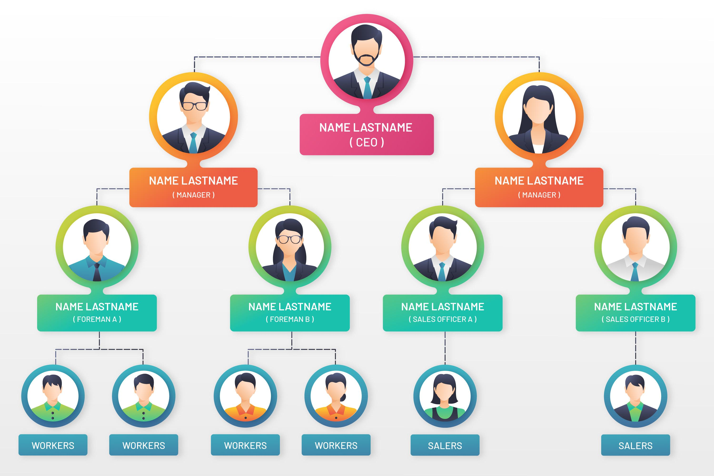

WHO ARE THE END USERS?

Slide 7

OUR SOLUTION AND ITS VALUE PROPOSITION
CONDITIONAL FORMATTING - MISSING
FILTER -REMOVE
FORMULA-PERFORRMANCE
PIVOT - SUMMARY
GRAPH-DATA VISUALIZTION

Slide 8
Dataset Description
EMPLOYEE = KAGGLE
26-FEATURES
9 FEATURE
EMP TYPE
PERFORMANCE LEVEL
GENDER -MAALE FEMALE
EMPLOYEE RATING -NUM

Slide 9

THE "WOW" IN OUR SOLUTION
PERFORMANCE LEVEL =IFS(Z8>=5”VERY HIGH”,
Z8>=4”HIGH’’,Z8>=3”,MED”,TRUE,”LOW”)
3/21/2024 Annual Review

Slide 10
MODELLING
DATA COLLECTION
GAGGLE TO DOWNLOAD THE DATA
FETURE COLLECTION
Employee status
Employee Type
Gender code
Performance Score
Current Employee Rating
DATA CLEANING
MISSING VALUE IDENTIFY
MISSING VALUE FILTER
PERFORMANCE LEVEL
SUMMARY
CREATE A PIVOT TABLE
CREATING GRAPH

Slide 11
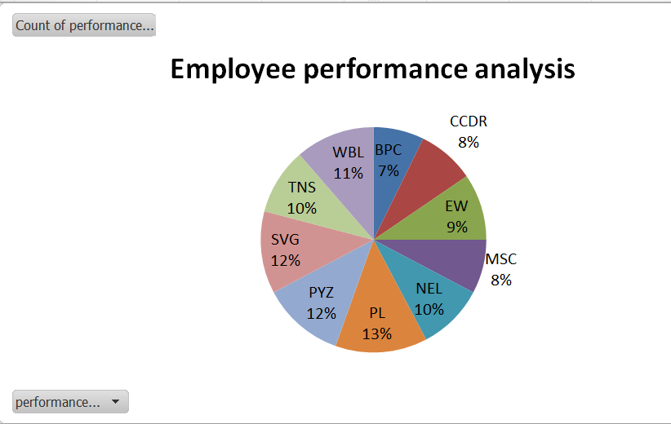
RESULTS

Slide 12
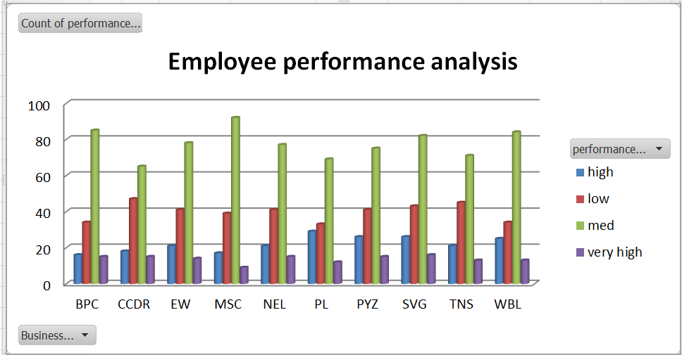

Slide 13
conclusion
By comparing the performance of the employee
employee the number of employee are higher
the number average performance by employee
by giving them different level of task based on their performance and the work .....we need to motivate them for the better outcome....

